Slide 1

CMR COLLEGE OF ENGINEERING & TECHNOLOGY
Kandlakoya, Medchal, Hyderabad - 501401
Department of Computer Science and Engineering
Machine Learning Methods for Attack Detection in the Smart Grid
Name of the student
batch:36 Md. Moqeed (20H51A05A1)
P. Shiva Charan (20H51A05J1)
S.Neeraj Kumar (20H51A05J6)
Under esteemed guidance of Ms.P. Sravanthi
Assistant Professor

Slide 2
Outline
Abstract
Introduction
Literature survey
Existing system
- Problems in existing system
Research Objective of Presentation
Problem Definition
Research work
- Proposed system architecture
- Methods
- workdown Structure
- proposed output
Results
Conclusion
Future Work
References
Notes:
2

Slide 3
Abstract
Notes:
3

Slide 4
ABSTRACT
Attack detection problems in the smart grid are posed as statistical learning problems for different attack scenarios in which the measurements are observed in batch or online settings.
In this approach, machine learning algorithms are used to classify measurements as being either secure or attacked. An attack detection framework is provided to exploit any available prior knowledge about the system and surmount constraints arising from the sparse structure of the problem in the proposed approach.
. The relationships between statistical and geometric properties of attack vectors employed in the attack scenarios and learning algorithms are analyzed to detect unobservable attacks using statistical learning methods.
Experimental analyses show that machine learning algorithms can detect attacks with performances higher than attack detection algorithms that employ state vector estimation methods in the proposed attack detection framework.

Slide 5
INTRODUCTION
Notes:
5

Slide 6
Introduction
MACHINE learning methods have been widely proposed in the smart grid literature for monitoring and control of power systems. suggest an intelligent framework for the system design, in which machine learning algorithms are employed to predict the failures of the system components.
Malicious activity prediction and intrusion detection problems have been analyzed using machine.
In this paper, we focus on the false data injection attack detection problem in the smart grid at the physical layer. We use the distributed sparse attacks model proposed in, where the attacks are directed by injecting false data into the local measurements observed by either local network operators.
In addition, network operators who employ statistical learning algorithms for attack detection know the topology of the network, measurements observed in the clusters, and the measurement matrix.
Notes:
6

Slide 7
Literature Survey
Notes:
7

Slide 8
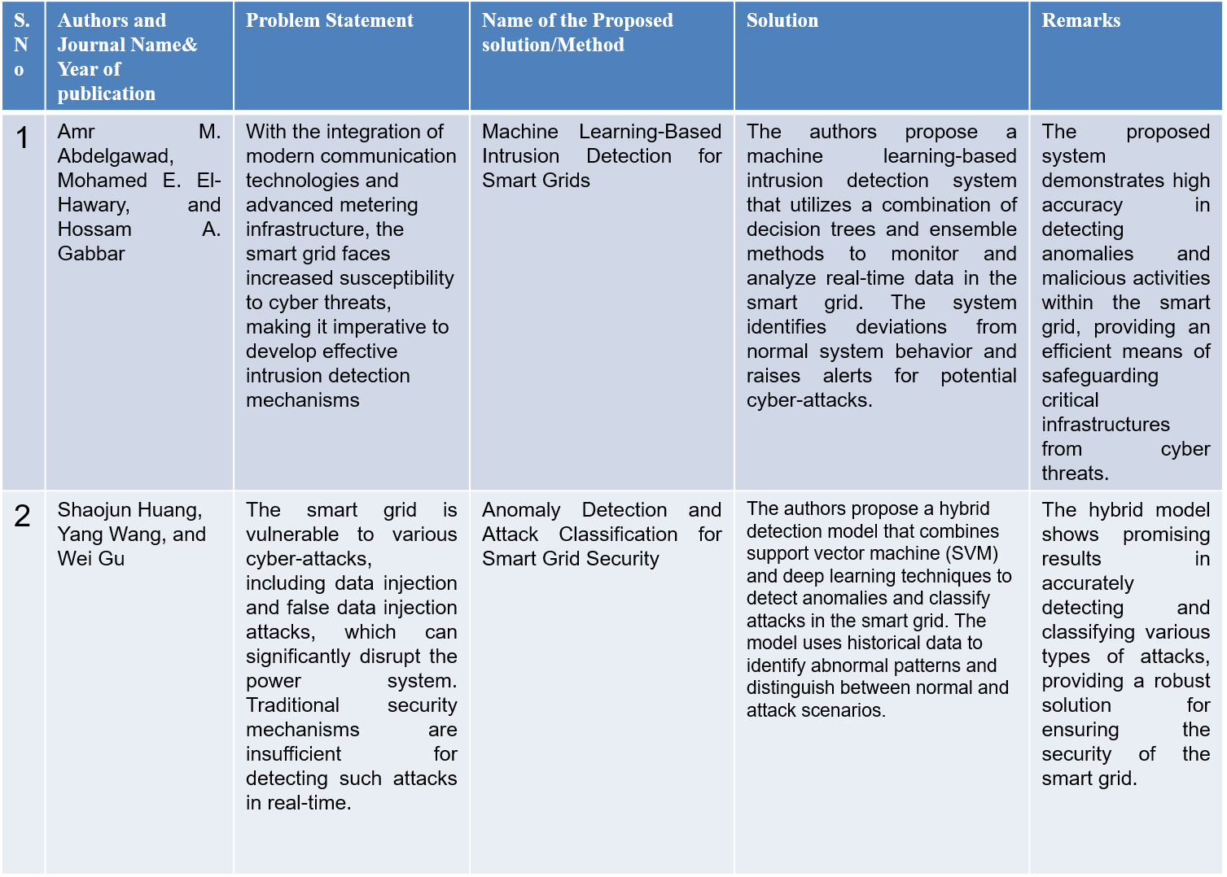
Existing system
Notes:
8

Slide 9
Research Objective
Notes:
9

Slide 10
Research objective
Attack Classification: Create a machine learning model that can accurately classify different types of attacks on the smart grid, including but not limited to cyberattacks (e.g., malware, DoS, insider threats) and physical attacks (e.g., tampering with physical components, theft of equipment).
Anomaly Detection: Develop algorithms to detect unusual and anomalous behavior within the smart grid, which might indicate an attack or system malfunction.
Real-time Monitoring: Implement a real-time monitoring system that continuously analyzes data from various sensors and devices within the smart grid to promptly identify and respond to threats.
Data Sources Integration: Integrate data from various sources, such as SCADA systems, IoT sensors, network logs, and historical data, to provide a comprehensive view of the grid's state

Slide 11
Research objective
Scalability: Ensure that the machine learning solution is scalable to accommodate the growing complexity of the smart grid and handle large volumes of data efficiently.
False Positive Reduction: Minimize false positives to prevent unnecessary alarm triggers and reduce the burden on operators.
Response Mechanism: Develop a response mechanism that can be activated upon the detection of an attack, including alerting, isolation, and recovery procedures.
Model Training and Adaptation: Implement a system that can continuously learn and adapt to new attack patterns and evolving threats.
Regulatory Compliance: Ensure that the solution complies with relevant regulations and standards for grid security.
User-Friendly Interface: Create a user-friendly interface for grid operators and security personnel to interact with the system, investigate alerts, and initiate responses.
Performance Metrics: Define and measure the performance metrics of the machine learning model, such as accuracy, false positive rate, detection time, and system availability during attacks.

Slide 12
Problem Definition
Notes:
12

Slide 13
Problem Definition
Attack detection problems in the smart grid are posed as statistical learning problems for different attack scenarios in which the measurements are observed in batch or online settings.
In this approach, machine learning algorithms are used to classify measurements as being either secure or attacked. Machine learning algorithms can make prediction by analysing past historical data.

Slide 14
Research Work
Notes:
14

Slide 15
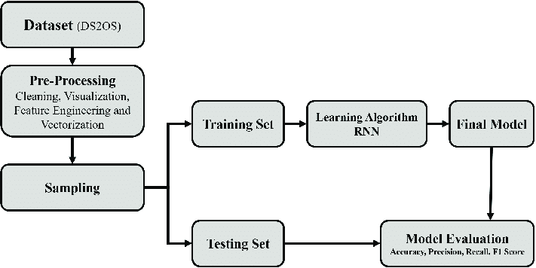
Proposed system

Slide 16
Proposed Methods
This Project Mainly identifies three key areas where machine learning can benefit smart grids, Predictive maintenance, Load and energy source management, Cybersecurity.
This work specifically addresses the challenge of detecting physical-layer attacks, where attackers inject fraudulent data into local measurements.
The Frontend part is developed using Web Framework, tkinter, and Backend part is developed using machine learning in python.
We use machine learning algorithms like KNN, SVM, Perceptron and Logistic Regression to get High Accuracy and Quick Response.
Machine learning algorithms can make prediction by analysing past historical data.

Slide 17
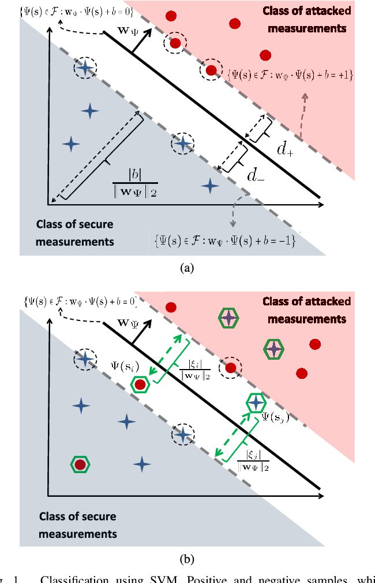
Work Down Structure:

Slide 18
Result Analysis
The result of this project is a strengthened smart grid that is more secure, responsive, and resilient.
The machine learning-based attack detection system effectively identifies and mitigates threats, safeguarding the grid's integrity and minimizing downtime.
This enhanced security ensures the reliable delivery of electrical power and protects critical infrastructure.
The project streamlines operations, reduces false alarms, and offers data-driven insights into grid performance.
The outcome is a more adaptive and secure smart grid, contributing to long-term sustainability and uninterrupted power supply to communities and industries.

Slide 19
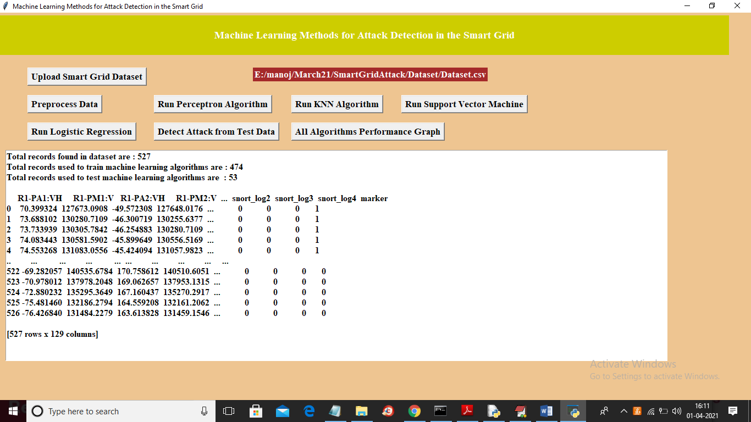
Proposed Output

Slide 20
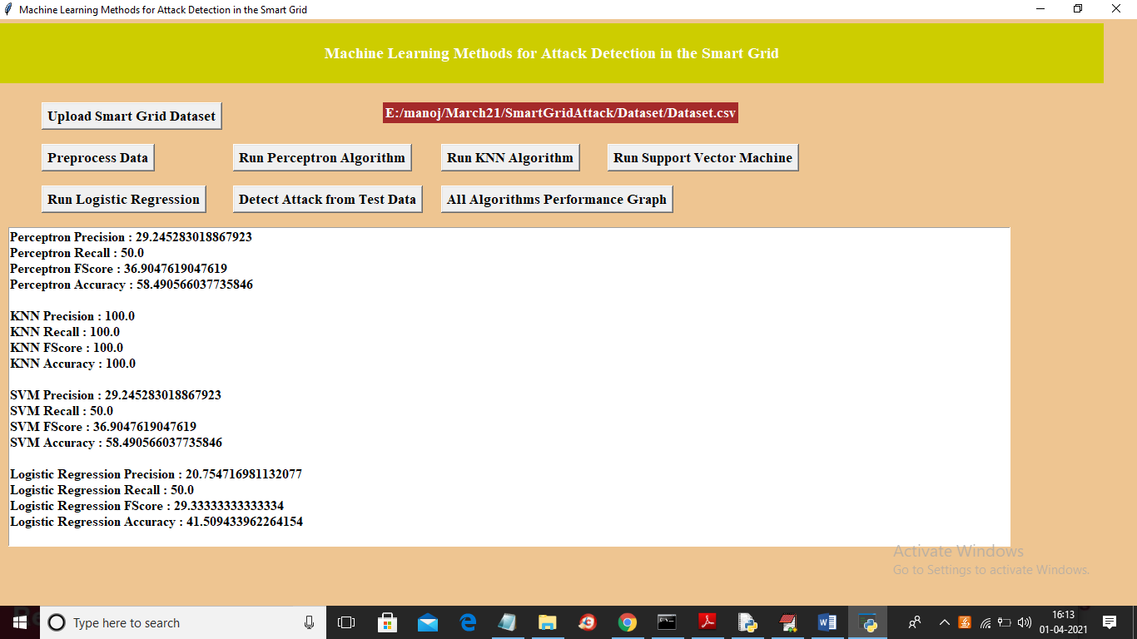

Slide 21
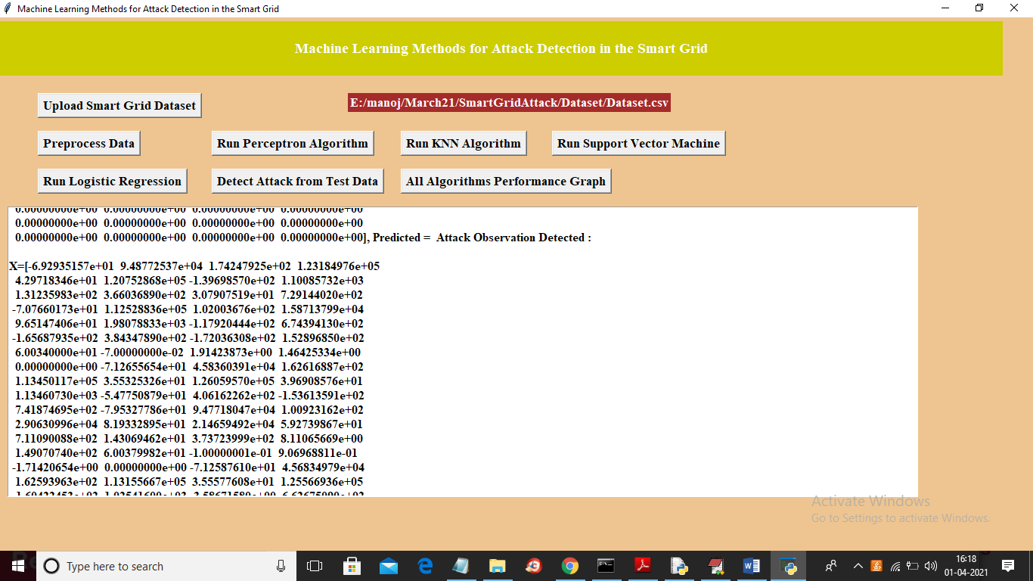

Slide 22
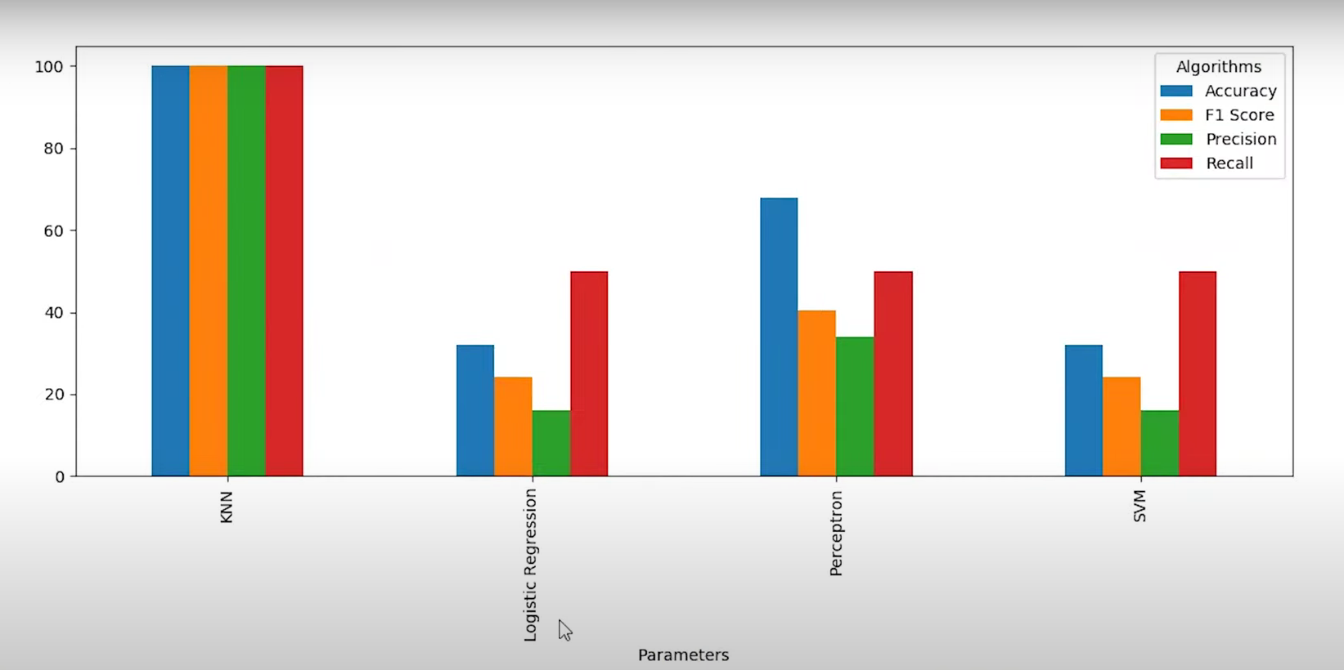
Performance Measure

Slide 23
Conclusion
The attack detection problem has been reformulated as a machine learning problem and the performance of supervised, semisupervised, classifier and feature space fusion, and online learning algorithms have been analyzed for different attack scenarios.
In a supervised binary classification problem, the attacked and secure measurements are labeled in two separate classes. In the experiments, we have observed that the state-of-the-art machine learning algorithms perform better than the well-known attack detection algorithms that employ an SVE approach for the detection of both observable and unobservable attacks.

Slide 24
Future work
Hybrid Models
Optimization and Hyperparameter Tuning
Feature Engineering for Specific Attacks
Imbalanced Data Handling
Adaptive Learning and Transfer Learning
Online Learning and Incremental Learning
Robustness and Adversarial Defense

Slide 25
References
1. C. Rudin et al., “Machine learning for the New York City power grid,” IEEE Trans. Pattern Anal. Mach. Intell., vol. 34, no. 2, pp. 328–345, Feb. 2012.
2. R. N. Anderson, A. Boulanger, W. B. Powell, and W. Scott, “Adaptive stochastic control for the smart grid,” Proc. IEEE, vol. 99, no. 6, pp. 1098–1115, Jun. 2011
3. Z. M. Fadlullah, M. M. Fouda, N. Kato, X. Shen, and Y. Nozaki, “An early warning system against malicious activities for smart grid communications,” IEEE Netw., vol. 25, no. 5, pp. 50–55, Sep./Oct. 2011.

Slide 26
Thank You!

